Slide 2
Lecture 15: Introduction to Interactive Petrophysics (IP Software)
Principle of IP Software
Working with single well
Introduction to IP:
Navigate IP interface
IP Database
Overview of IP basic workflow

Slide 3
Introduction to IP:
Loading Log Data
Edit/View Log
Crossplot and Histogram
Introduction to Log plot
Calculation, Env. Corrections

Slide 4
Application of IP software (Log Interpretation):
Clay Volume Calculation.
Porosity and Water saturation.
Cutoff and Summation.
Exporting well data.
Multi well interpretation

Slide 5
Principle of IP Software
Interactive Petrophysics is a PC based software application.
Multi well multi zone reservoir property analysis.
Wide range of options
Provide Freedom to explore a range of interpretation before saving to the data base.

Slide 6
Working with single well
Introduction to IP
Navigate IP interface
IP Database
Overview of IP basic workflow
Data loading
Introduction to log Plot
Log Editing
Cross Plot and histogram

Slide 7
IP Database
An IP database (project) consists of a group of wells
In set of binary files grouped together in 1 folder
A project holds 9999 wells, with 200 wells loaded onto the memory at one time
Locking Mechanism (IPDB Lock)

Slide 8
IP Database is
A subdirectory for each IP user using a database
Each well stored in the IP project directory consists of :
Curve data : IPDBWellxxxx.dat
General well information : IPDBProj.dat
Interpretation Parameter : .set(cutoff.set,phisw.set)
Clay vol. set
IPD Block file

Slide 9
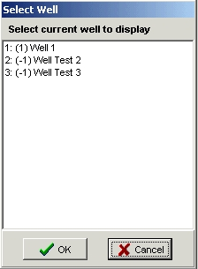
-1 means well is not saved in DB.
Memory well number

Slide 10
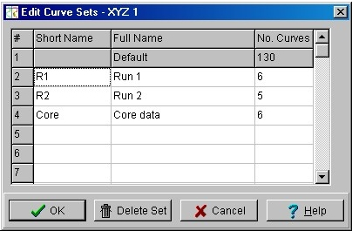
Curve Sets
Short name : max of 4 letters and is always appended to the front of the curve name (example, R1:GR)
Long name, used to document the purpose of the set
Notes:
In each curve set, the curve name is unique. Curve names can be the same but have to be stored in different curve sets.

Slide 11
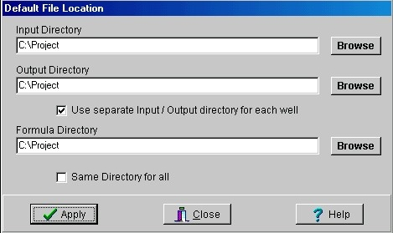
Default File Locations
Input Storage Location
Output Storage Location
Formula Storage Location

Slide 12
Basic Workflow
Load data
Generate a summary report
View/Edit data
Depth Match, Splice, Env. Corr.
Define log cutoffs
Calculate Volume of Shale
Calculate Saturation
Create zones
Calculate Porosity

Slide 13
Loading Log Data
Notes:
The exercises using the current IP manual will only include ASCII and LAS load.

Slide 14
Edit/View Log data
Notes:
Only the highlighted options will be included in the exercises using current IP manual.

Slide 15
Log Plot & Data Editing
Similar to Well Composite or Well Edit modules in GeoFrame
Provides a graphical interface to display digital log data
Provides several templates *.plt (like LGP in GeoFrame)
Log Editing
Curve splicing
Depth shifting
SP Baseline
Curve editing
Temp Gradient
Curve Filter and Average
Notes:
Demonstration is a must before students do the exercises.
Show the students on how to work with Log Plot.

Slide 16
Cross Plot Used to analyze relationships between data
Provides statistical regression line-fitting
Provides pre-defined overlays
Users can create areas and generate curves from the areas

Slide 17
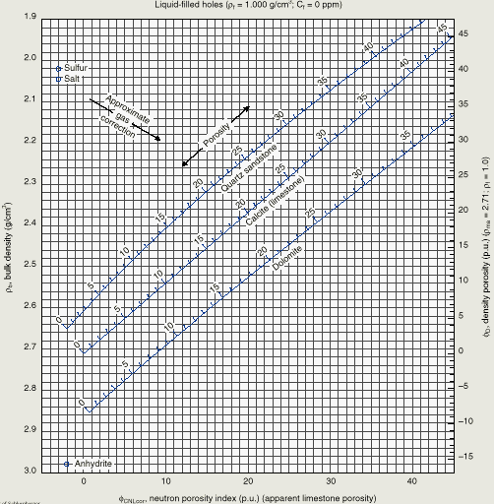
Neutron- Density Cross Plots
This crossplot has ρb plotted against the corrected neutron porosity
Fluid density in this plot is 1.0 g/cm3

Slide 18
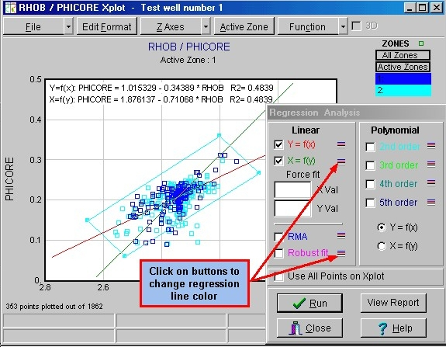
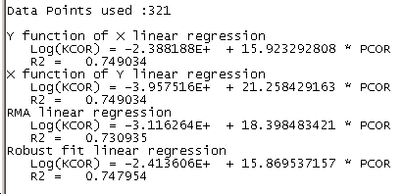

Slide 19
Calculation, Env. Corrections

Slide 20
Log Interpretation

Slide 21
Clay Volume
Single Clay Indicator
Double Clay Indicator
Only single clay indicator
Provide access to Xplot

Slide 22
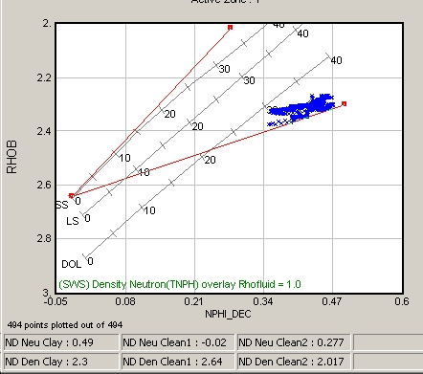
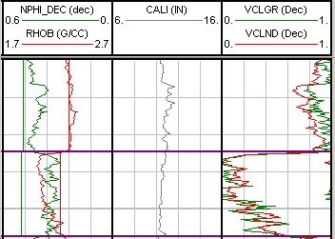
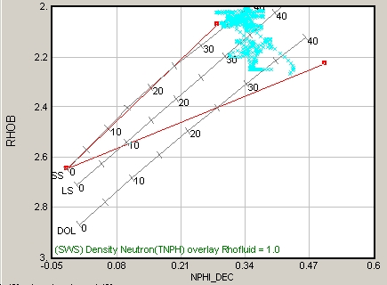
Double Clay Indicator
RHOB/NPHI XPlot
Shale line Indicator

Slide 23
Porosity and Water Saturation

Slide 24
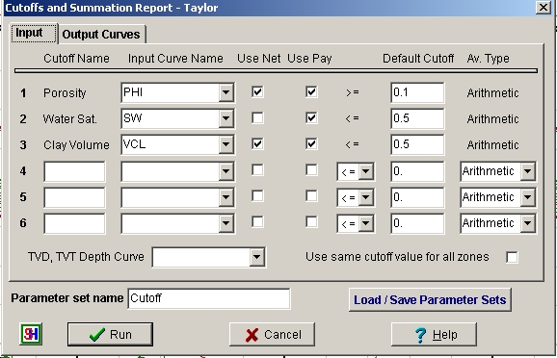
Reservoir Summation

